Slide 1
Welcome to Bible Jam
Fall / Winter Semester
November 16, 2021

Slide 2
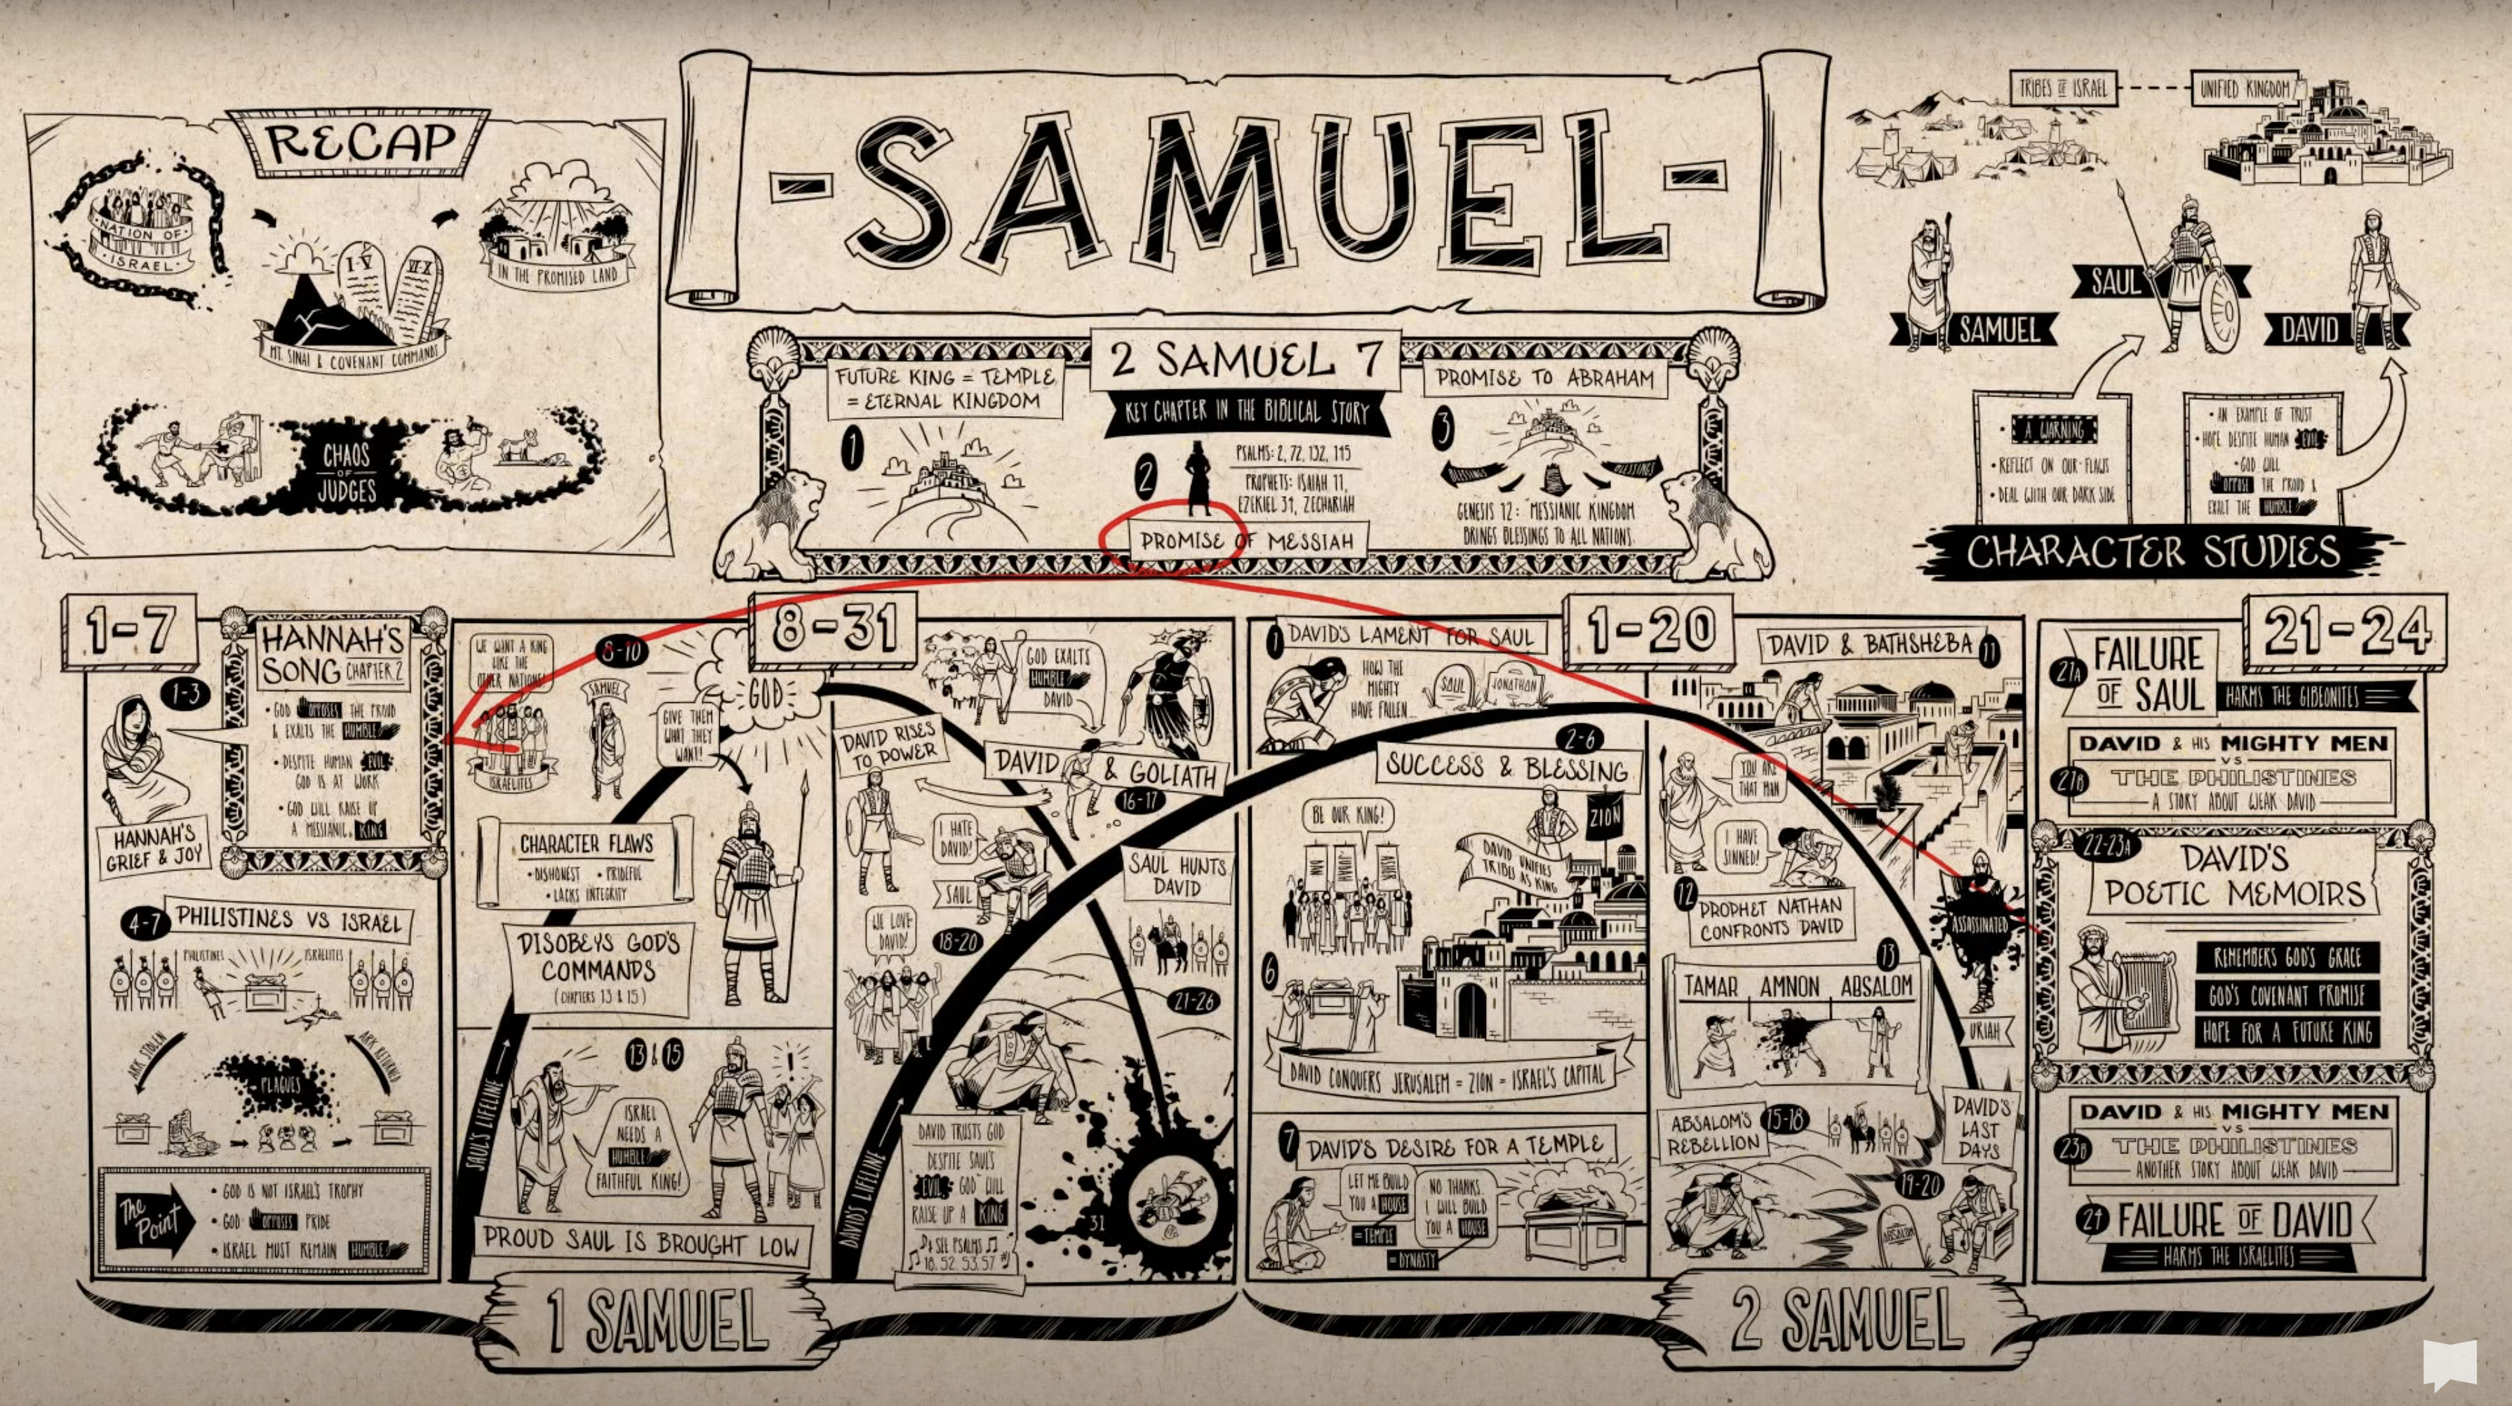
Check-In

Slide 3
Class Notes:
http://www.sayvilleucc.org/

Slide 4
David 1
David 2
http://www.sayvilleucc.org/

Slide 5
Nunc Dimitis
Song of Simeon

Slide 9
What did you learn?
What will you remember?
What more would you like to know?

